Slide 1
Computer Security Laboratory
Towards Confidential Computing with Trusted Execution Environment
Zhiqiang Lin
zlin@cse.ohio-state.edu
3/11/2021
THE OHIO STATE UNIVERSITY

Slide 2
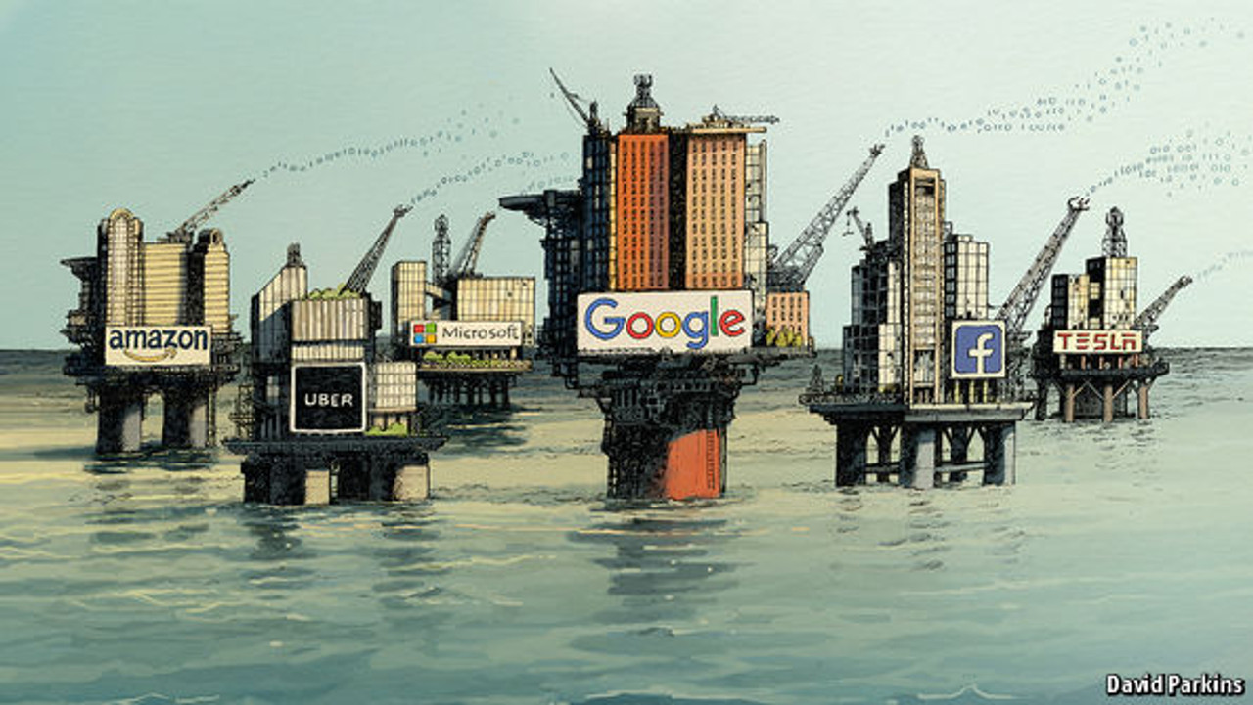
Data Has Become the World’s Most Valuable Resource
"The world’s most valuable resource is no longer oil, but data." The Economist: New York, NY, USA (2017).

Slide 3
Data is Under the Danger of Being Leaked or Abused

Slide 4
Data is Under the Danger of Being Leaked or Abused
Uber
Date: October, 2016 Impact: 57 million drivers and customers
Forfeit: $148 million

Slide 5
Data is Under the Danger of Being Leaked or Abused
Equifax
Date: July, 2017 Impact: 147.9 million consumers
Forfeit: $575 million
Uber
Date: October, 2016 Impact: 57 million drivers and customers
Forfeit: $148 million

Slide 6
Data is Under the Danger of Being Leaked or Abused
Equifax
Date: July, 2017 Impact: 147.9 million consumers
Forfeit: $575 million
Uber
Date: October, 2016 Impact: 57 million drivers and customers
Forfeit: $148 million
British Airways
Date: September, 2018 Impact: 500,000 customers
Forfeit: £183m

Slide 7
Data is Under the Danger of Being Leaked or Abused
Equifax
Date: July, 2017 Impact: 147.9 million consumers
Forfeit: $575 million
Marriott
Date: November, 2018 Impact: 500 million guests
Forfeit: £ 99 million
Uber
Date: October, 2016 Impact: 57 million drivers and customers
Forfeit: $148 million
British Airways
Date: September, 2018 Impact: 500,000 customers
Forfeit: £183m

Slide 8
Data is Under the Danger of Being Leaked or Abused
Equifax
Date: July, 2017 Impact: 147.9 million consumers
Forfeit: $575 million
Marriott
Date: November, 2018 Impact: 500 million guests
Forfeit: £ 99 million
Cambridge Analytica
Date: 2013-2018 Impact: Over 50 million Facebook users
Forfeit: Bankruptcy, $5 B
Uber
Date: October, 2016 Impact: 57 million drivers and customers
Forfeit: $148 million
British Airways
Date: September, 2018 Impact: 500,000 customers
Forfeit: £183m

Slide 9
Data is Under the Danger of Being Leaked or Abused
Equifax
Date: July, 2017 Impact: 147.9 million consumers
Forfeit: $575 million
Marriott
Date: November, 2018 Impact: 500 million guests
Forfeit: £ 99 million
Cambridge Analytica
Date: 2013-2018 Impact: Over 50 million Facebook users
Forfeit: Bankruptcy, $5 B
Uber
Date: October, 2016 Impact: 57 million drivers and customers
Forfeit: $148 million
British Airways
Date: September, 2018 Impact: 500,000 customers
Forfeit: £183m

Slide 10
Key Technology: Confidential Computing
Multi-Party Computation (MPC)
Homomorphic Encryption
Differential Privacy (DP)
Federated Learning
Trusted Execution Environments (TEE)

Slide 11
Key Technology: Confidential Computing
Multi-Party Computation (MPC)
Homomorphic Encryption
Differential Privacy (DP)
Federated Learning
Trusted Execution Environments (TEE)

Slide 12
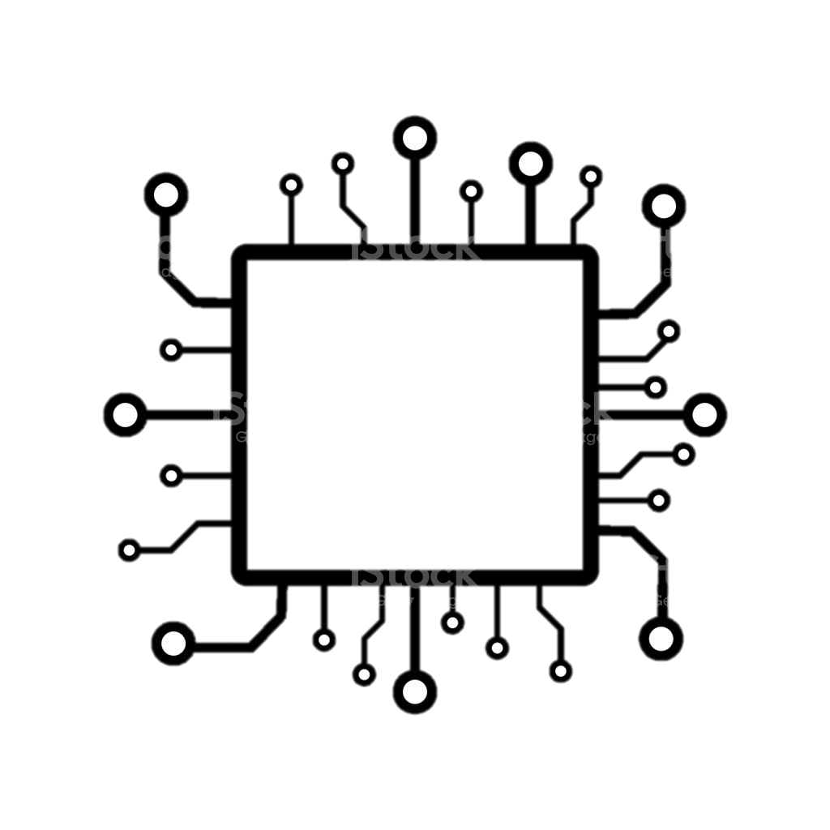
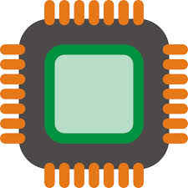
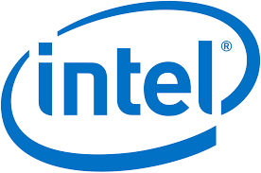
Trusted Execution Environments (TEE)
Intel SGX
ARM TrustZone
AMD SEV

Slide 13
Why Trusted Execution Environments (TEE)
Operating Systems
Hardware

Slide 14
Why Trusted Execution Environments (TEE)
Operating Systems
Hardware

Slide 15
Why Trusted Execution Environments (TEE)
Operating Systems
Hardware

Slide 16
Why Trusted Execution Environments (TEE)
Operating Systems
Hardware

Slide 17
Why Trusted Execution Environments (TEE)
Operating Systems
Hardware

Slide 18
Why Trusted Execution Environments (TEE)
Operating Systems
Hardware

Slide 19
Why Trusted Execution Environments (TEE)
Operating Systems
Hardware

Slide 20
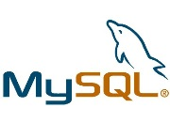
Why Trusted Execution Environments (TEE)
Operating Systems
Linux Kernel
Virtualization
Hardware

Slide 21
Why Trusted Execution Environments (TEE)
Operating Systems
Linux Kernel
Virtualization
Hardware

Slide 22
Why Trusted Execution Environments (TEE)
Operating Systems
Linux Kernel
Virtualization
Hardware

Slide 23
Why Trusted Execution Environments (TEE)
Operating Systems
Linux Kernel
Virtualization
Hardware

Slide 24
Why Trusted Execution Environments (TEE)
Operating Systems
Linux Kernel
Virtualization
Hardware

Slide 25
Why Trusted Execution Environments (TEE)
Operating Systems
Linux Kernel
Virtualization
Hardware
TEE

Slide 26
Why Trusted Execution Environments (TEE)
Operating Systems
Linux Kernel
Virtualization
Hardware
TEE

Slide 27
TEE (Intel SGX)
Physical
Memory
Address
Space
CPU Package
Enclave
Processor Key
EPC
Encrypted
code/data
Enclave
Memory Encryption
Engine (MEE)

Slide 28
TEE (Intel SGX)
Physical
Memory
Address
Space
CPU Package
Access from
OS/Hypervisor
Enclave
Processor Key
EPC
Access b/w
enclaves
Snooping
Encrypted
code/data
Enclave
Memory Encryption
Engine (MEE)

Slide 29
Outline
❶ Motivation
❷ Our Efforts
❸ Applications
❹ Takeaway

Slide 30
Our Research Efforts w/ TEE

Slide 31
Our Research Efforts w/ TEE
From: Walls, Rhonda <rah018300@utdallas.edu>
Sent: Thursday, November 19, 2015 3:08 PM To: Lin, Zhiqiang Cc: Bauman, Erick; Fu, Yangchun Subject: The SGX laptop
Dr. Lin, the laptop was delivered to Erick just now.

Slide 32
Our Research Efforts w/ TEE
2016.12
Protecting Games With SGX
Systex 2016

Slide 33
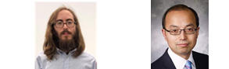
Our Research Efforts w/ TEE
2016.12
"A Case for Protecting Computer Games With SGX". Erick Bauman, and Zhiqiang Lin. In Proceedings of the 1st Workshop on System Software for Trusted Execution, Trento, Italy. December 2016
Protecting Games With SGX
Systex 2016

Slide 34
Our Research Efforts w/ TEE
2016.12
Protecting Games With SGX
Systex 2016

Slide 35
Our Research Efforts w/ TEE
AsiaCCS 2017
SGX-LOG
2016.12
2017.4
Protecting Games With SGX
Systex 2016

Slide 36
Our Research Efforts w/ TEE
"SGX-Log: Securing System Logs With SGX". Vishal Karande, Erick Buaman, Zhiqiang Lin, and Latifur Khan. In Proceedings of the 12th ACM Asia Conference on Computer and Communications Security, Abu Dhabi. April 2017
AsiaCCS 2017
SGX-LOG
2016.12
2017.4
Protecting Games With SGX
Systex 2016

Slide 37
Our Research Efforts w/ TEE
AsiaCCS 2017
SGX-LOG
2016.12
2017.4
Protecting Games With SGX
Systex 2016

Slide 38
Our Research Efforts w/ TEE
AsiaCCS 2017
RAID 2017
SGX-LOG
SGX-LAPD
2016.12
2017.4
2017.10
Protecting Games With SGX
Systex 2016

Slide 39
Our Research Efforts w/ TEE
“SGX-LAPD. Thwarting Controlled Side Channel Attacks via Enclave Verifiable Page Faults". Yangchun Fu, Erick Bauman, Raul Quinonez, and Zhiqiang Lin. In Proceedings of the 20th International Symposium on Research in Attacks, Intrusions and Defenses, Atlanta, Georgia. September 2017
AsiaCCS 2017
RAID 2017
SGX-LOG
SGX-LAPD
2016.12
2017.4
2017.10
Protecting Games With SGX
Systex 2016

Slide 40
Our Research Efforts w/ TEE
AsiaCCS 2017
RAID 2017
SGX-LOG
SGX-LAPD
2016.12
2017.4
2017.10
Protecting Games With SGX
Systex 2016

Slide 41
Our Research Efforts w/ TEE
AsiaCCS 2017
RAID 2017
SGX-LOG
SGX-LAPD
2016.12
2017.10
2017.4
2017.10
Protecting Games With SGX
SGX-Rand
Systex 2016
ESORICS 2017

Slide 42
Our Research Efforts w/ TEE
"Securing Data Analytics on SGX With Randomization". Swarup Chandra, Vishal Karande, Zhiqiang Lin, Latifur Khan, Murat Kantarcioglu, and Bhavani Thuraisingham. In Proceedings of the 22nd European Symposium on Research in Computer Security, Oslo, Norway. September, 2017
AsiaCCS 2017
RAID 2017
SGX-LOG
SGX-LAPD
2016.12
2017.10
2017.4
2017.10
Protecting Games With SGX
SGX-Rand
Systex 2016
ESORICS 2017

Slide 43
Our Research Efforts w/ TEE
AsiaCCS 2017
RAID 2017
SGX-LOG
SGX-LAPD
2016.12
2017.10
2017.4
2017.10
Protecting Games With SGX
SGX-Rand
Systex 2016
ESORICS 2017

Slide 44
Our Research Efforts w/ TEE
AsiaCCS 2017
RAID 2017
CCS 2017
SGX-LOG
SGX-LAPD
SGX-BigMatrix
2016.12
2017.10
2017.4
2017.10
2017.11
Protecting Games With SGX
SGX-Rand
Systex 2016
ESORICS 2017

Slide 45
Our Research Efforts w/ TEE
"SGX-BigMatrix: A Practical Encrypted Data Analytic Framework With Trusted Processors". Fahad Shaon, Murat Kantarcioglu, Zhiqiang Lin, and Latifur Khan. In Proceedings of the 24th ACM Conference on Computer and Communications Security, Dallas, Texas. November 2017.
AsiaCCS 2017
RAID 2017
CCS 2017
SGX-LOG
SGX-LAPD
SGX-BigMatrix
2016.12
2017.10
2017.4
2017.10
2017.11
Protecting Games With SGX
SGX-Rand
Systex 2016
ESORICS 2017

Slide 46
Our Research Efforts w/ TEE
AsiaCCS 2017
RAID 2017
CCS 2017
SGX-LOG
SGX-LAPD
SGX-BigMatrix
2016.12
2017.10
2017.4
2017.10
2017.11
Protecting Games With SGX
SGX-Rand
Systex 2016
ESORICS 2017

Slide 47
Our Research Efforts w/ TEE
AsiaCCS 2017
RAID 2017
CCS 2017
SGX-LOG
SGX-LAPD
SGX-BigMatrix
2016.12
2017.10
2018.2
2017.4
2017.10
2017.11
Protecting Games With SGX
SGX-Rand
SGX-Elide
Systex 2016
ESORICS 2017
CGO 2018

Slide 48
Our Research Efforts w/ TEE
"SGX-Elide: Enabling Enclave Code Secrecy via Self-Modification". Erick Bauman, Huibo Wang, Mingwei Zhang, and Zhiqiang Lin. In Proceedings of International Symposium on Code Generation and Optimization, Vienna, Austria, February 2018
AsiaCCS 2017
RAID 2017
CCS 2017
SGX-LOG
SGX-LAPD
SGX-BigMatrix
2016.12
2017.10
2018.2
2017.4
2017.10
2017.11
Protecting Games With SGX
SGX-Rand
SGX-Elide
Systex 2016
ESORICS 2017
CGO 2018

Slide 49
Our Research Efforts w/ TEE
AsiaCCS 2017
RAID 2017
CCS 2017
SGX-LOG
SGX-LAPD
SGX-BigMatrix
2016.12
2017.10
2018.2
2017.4
2017.10
2017.11
Protecting Games With SGX
SGX-Rand
SGX-Elide
Systex 2016
ESORICS 2017
CGO 2018

Slide 50
Our Research Efforts w/ TEE
AsiaCCS 2017
RAID 2017
CCS 2017
Euro S&P 2019
SGX-LOG
SGX-LAPD
SGX-BigMatrix
SGX-Pectre Attack
2016.12
2017.10
2018.2
2017.4
2017.10
2017.11
2019.6
Protecting Games With SGX
SGX-Rand
SGX-Elide
Systex 2016
ESORICS 2017
CGO 2018

Slide 51
Our Research Efforts w/ TEE
“Stealing Intel Secrets from SGX Enclaves via Speculative Execution". Guoxing Chen, Sanchuan Chen, Yuan Xiao, Yinqian Zhang, Zhiqiang Lin, and Ten H. Lai. In Proceedings of the 4th IEEE European Symposium on Security and Privacy, June 2019
AsiaCCS 2017
RAID 2017
CCS 2017
Euro S&P 2019
SGX-LOG
SGX-LAPD
SGX-BigMatrix
SGX-Pectre Attack
2016.12
2017.10
2018.2
2017.4
2017.10
2017.11
2019.6
Protecting Games With SGX
SGX-Rand
SGX-Elide
Systex 2016
ESORICS 2017
CGO 2018

Slide 52
Our Research Efforts w/ TEE
AsiaCCS 2017
RAID 2017
CCS 2017
Euro S&P 2019
SGX-LOG
SGX-LAPD
SGX-BigMatrix
SGX-Pectre Attack
2016.12
2017.10
2018.2
2017.4
2017.10
2017.11
2019.6
Protecting Games With SGX
SGX-Rand
SGX-Elide
Systex 2016
ESORICS 2017
CGO 2018

Slide 53
Our Research Efforts w/ TEE
AsiaCCS 2017
RAID 2017
CCS 2017
Euro S&P 2019
SGX-LOG
SGX-LAPD
SGX-BigMatrix
SGX-Pectre Attack
2017.10
2018.2
2019.8
2016.12
2017.4
2017.10
2017.11
2019.6
Protecting Games With SGX
SGX-Rand
SGX-Elide
AMD-SEV I/O
Security Attack
Systex 2016
USENIX Security 2019
ESORICS 2017
CGO 2018

Slide 54
Our Research Efforts w/ TEE
AsiaCCS 2017
RAID 2017
CCS 2017
Euro S&P 2019
SGX-LOG
SGX-LAPD
SGX-BigMatrix
SGX-Pectre Attack
2017.10
2018.2
2019.8
2016.12
2017.4
2017.10
2017.11
2019.6
"Exploiting Unprotected I/O Operations in AMD's Secure Encrypted Virtualization", Mengyuan Li, Yinqian Zhang, Zhiqiang Lin, Yan Solihin. In Proceedings of the 2019 USENIX Security Symposium, Santa Clara. August 2019.
Protecting Games With SGX
SGX-Rand
SGX-Elide
AMD-SEV I/O
Security Attack
Systex 2016
USENIX Security 2019
ESORICS 2017
CGO 2018

Slide 55
Our Research Efforts w/ TEE
AsiaCCS 2017
RAID 2017
CCS 2017
Euro S&P 2019
SGX-LOG
SGX-LAPD
SGX-BigMatrix
SGX-Pectre Attack
2017.10
2018.2
2019.8
2016.12
2017.4
2017.10
2017.11
2019.6
Protecting Games With SGX
SGX-Rand
SGX-Elide
AMD-SEV I/O
Security Attack
Systex 2016
USENIX Security 2019
ESORICS 2017
CGO 2018

Slide 56
Our Research Efforts w/ TEE
AsiaCCS 2017
RAID 2017
CCS 2017
Euro S&P 2019
CCS 2019
SGX-LOG
SGX-LAPD
SGX-BigMatrix
SGX-Pectre Attack
Rust-SGX
2017.10
2018.2
2019.8
2016.12
2017.4
2017.10
2017.11
2019.6
2019.11
Protecting Games With SGX
SGX-Rand
SGX-Elide
AMD-SEV I/O
Security Attack
Systex 2016
USENIX Security 2019
ESORICS 2017
CGO 2018

Slide 57
Our Research Efforts w/ TEE
"Towards Memory Safe Enclave Programming with Rust-SGX". Huibo Wang, Pei Wang, Yu Ding, Mingshen Sun, Yiming Jing, Ran Duan, Long Li, Yulong Zhang, Tao Wei, and Zhiqiang Lin. In Proceedings of the 26th ACM Conference on Computer and Communications Security, London, UK. November 2019
AsiaCCS 2017
RAID 2017
CCS 2017
Euro S&P 2019
CCS 2019
SGX-LOG
SGX-LAPD
SGX-BigMatrix
SGX-Pectre Attack
Rust-SGX
2017.10
2018.2
2019.8
2016.12
2017.4
2017.10
2017.11
2019.6
2019.11
Protecting Games With SGX
SGX-Rand
SGX-Elide
AMD-SEV I/O
Security Attack
Systex 2016
USENIX Security 2019
ESORICS 2017
CGO 2018

Slide 58
Our Research Efforts w/ TEE
AsiaCCS 2017
RAID 2017
CCS 2017
Euro S&P 2019
CCS 2019
SGX-LOG
SGX-LAPD
SGX-BigMatrix
SGX-Pectre Attack
Rust-SGX
2017.10
2018.2
2019.8
2016.12
2017.4
2017.10
2017.11
2019.6
2019.11
Protecting Games With SGX
SGX-Rand
SGX-Elide
AMD-SEV I/O
Security Attack
Systex 2016
USENIX Security 2019
ESORICS 2017
CGO 2018

Slide 59
Our Research Efforts w/ TEE
AsiaCCS 2017
RAID 2017
CCS 2017
Euro S&P 2019
CCS 2019
SGX-LOG
SGX-LAPD
SGX-BigMatrix
SGX-Pectre Attack
Rust-SGX
2017.10
2018.2
2019.8
2021
2016.12
2017.4
2017.10
2017.11
2019.6
2019.11
…..
Protecting Games With SGX
SGX-Rand
SGX-Elide
AMD-SEV I/O
Security Attack
Systex 2016
USENIX Security 2019
ESORICS 2017
CGO 2018

Slide 60
Our Research Efforts w/ TEE
AsiaCCS 2017
RAID 2017
CCS 2017
Euro S&P 2019
CCS 2019
SGX-LOG
SGX-LAPD
SGX-BigMatrix
SGX-Pectre Attack
Rust-SGX
2017.10
2018.2
2019.8
2021
2016.12
2017.4
2017.10
2017.11
2019.6
2019.11
…..
Protecting Games With SGX
SGX-Rand
SGX-Elide
AMD-SEV I/O
Security Attack
Systex 2016
USENIX Security 2019
ESORICS 2017
CGO 2018

Slide 61
SGX-BigMatrix (CCS’17)

Slide 62
SGX-BigMatrix (CCS’17)
Motivation
Building a robust, scalable, and secure big-data analytics application with SGX is non-trivial due to several shortcomings of the SGX architecture.

Slide 63
SGX-BigMatrix (CCS’17)
Motivation
Building a robust, scalable, and secure big-data analytics application with SGX is non-trivial due to several shortcomings of the SGX architecture.
Contributions
Generic framework for secure data analytics in an untrusted cloud setup. An abstraction for handling large matrix operations in a data oblivious way. A programming abstraction that can be used to execute a sequence of commands obliviously with optimum cost.

Slide 64
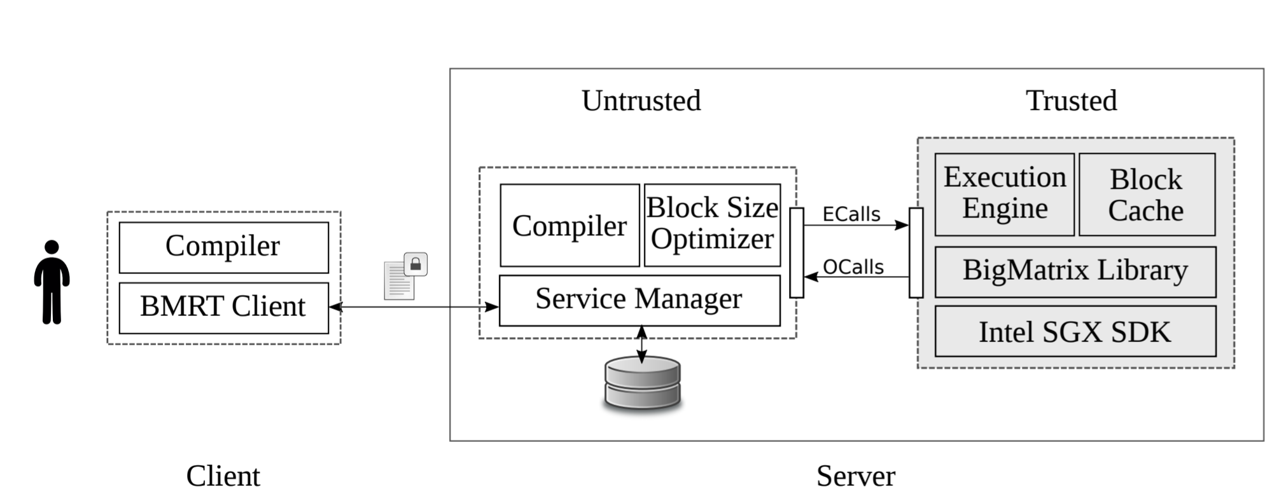
SGX-BigMatrix (CCS’17)
Motivation
Building a robust, scalable, and secure big-data analytics application with SGX is non-trivial due to several shortcomings of the SGX architecture.
Contributions
Generic framework for secure data analytics in an untrusted cloud setup. An abstraction for handling large matrix operations in a data oblivious way. A programming abstraction that can be used to execute a sequence of commands obliviously with optimum cost.
System Overview

Slide 65
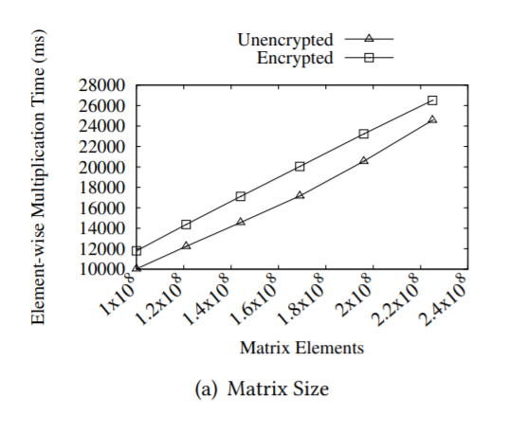
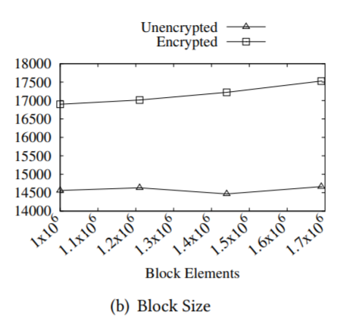
SGX-BigMatrix (CCS’17)
Motivation
Building a robust, scalable, and secure big-data analytics application with SGX is non-trivial due to several shortcomings of the SGX architecture.
Contributions
Generic framework for secure data analytics in an untrusted cloud setup. An abstraction for handling large matrix operations in a data oblivious way. A programming abstraction that can be used to execute a sequence of commands obliviously with optimum cost.
System Overview
Results

Slide 66
SGX-Elide (CGO’18)

Slide 67
SGX-Elide (CGO’18)
Motivation
Intel SGX enclave code prior to initialization can be easily disassembled and therefore no secrets can be embedded in the binary.

Slide 68
SGX-Elide (CGO’18)
Motivation
Intel SGX enclave code prior to initialization can be easily disassembled and therefore no secrets can be embedded in the binary.
Contributions
A systematic protection model for software that uses SGX. A framework for providing code confidentiality to SGX applications, thereby providing both code and data integrity and confidentiality. Our framework is easy to add to existing SGX projects and effective at protecting the confidentiality of code.

Slide 69
SGX-Elide (CGO’18)
Motivation
Intel SGX enclave code prior to initialization can be easily disassembled and therefore no secrets can be embedded in the binary.
Contributions
A systematic protection model for software that uses SGX. A framework for providing code confidentiality to SGX applications, thereby providing both code and data integrity and confidentiality. Our framework is easy to add to existing SGX projects and effective at protecting the confidentiality of code.
System Overview

Slide 70
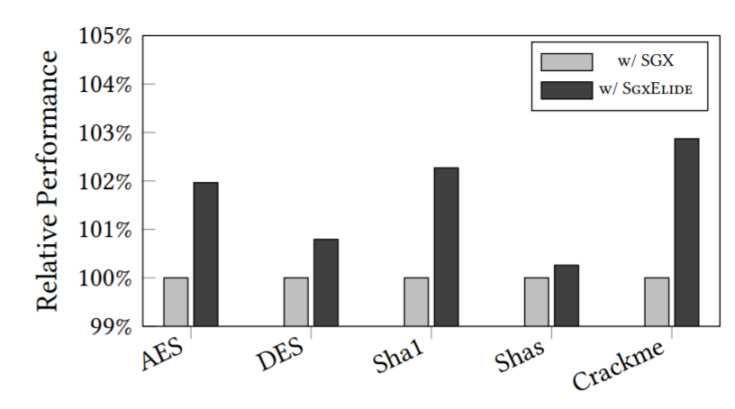
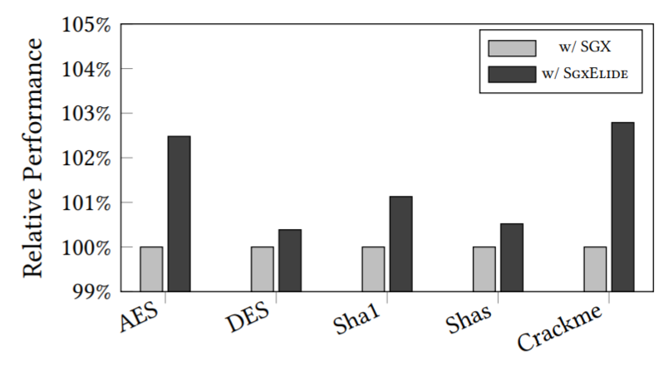
SGX-Elide (CGO’18)
Motivation
Intel SGX enclave code prior to initialization can be easily disassembled and therefore no secrets can be embedded in the binary.
Contributions
A systematic protection model for software that uses SGX. A framework for providing code confidentiality to SGX applications, thereby providing both code and data integrity and confidentiality. Our framework is easy to add to existing SGX projects and effective at protecting the confidentiality of code.
System Overview
Results

Slide 71
Rust-SGX (CCS’19)

Slide 72
Rust-SGX (CCS’19)
Motivation
The key objective of Rust-SGX is to remove memory corruption vulnerabilities inside SGX enclave by enabling the enclave software development with memory safe languages.

Slide 73
Rust-SGX (CCS’19)
Motivation
The key objective of Rust-SGX is to remove memory corruption vulnerabilities inside SGX enclave by enabling the enclave software development with memory safe languages.
Contributions
A practical and layered approach to exterminating memory corruptions for SGX enclave programs. We propose the use of type safety and formal proof to handle the unsafe components when dealing with a layered memory safety model. Our evaluation results show that Rust-SGX fully preserves the SGX functionality and meanwhile does not impose any significant performance overhead.

Slide 74
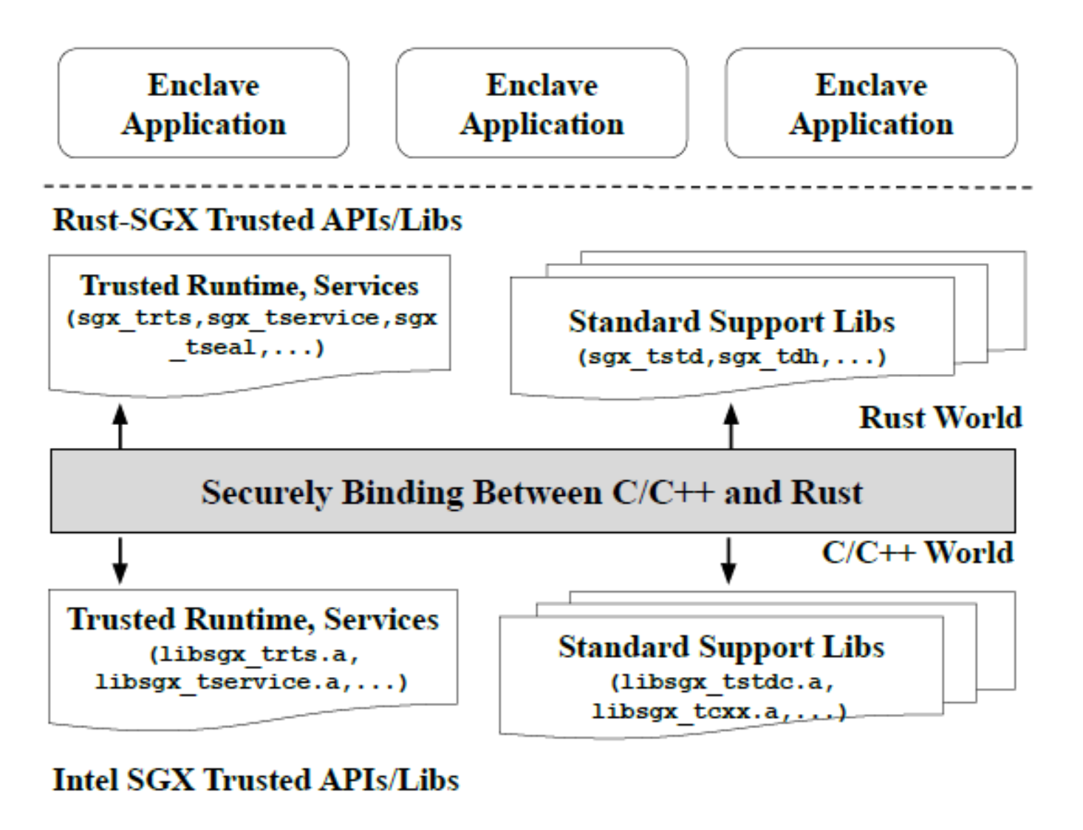
Rust-SGX (CCS’19)
Motivation
The key objective of Rust-SGX is to remove memory corruption vulnerabilities inside SGX enclave by enabling the enclave software development with memory safe languages.
Contributions
A practical and layered approach to exterminating memory corruptions for SGX enclave programs. We propose the use of type safety and formal proof to handle the unsafe components when dealing with a layered memory safety model. Our evaluation results show that Rust-SGX fully preserves the SGX functionality and meanwhile does not impose any significant performance overhead.
System Overview

Slide 75
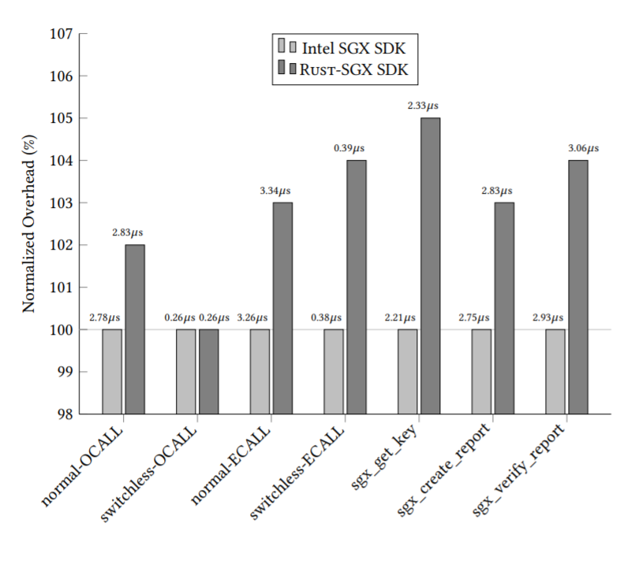
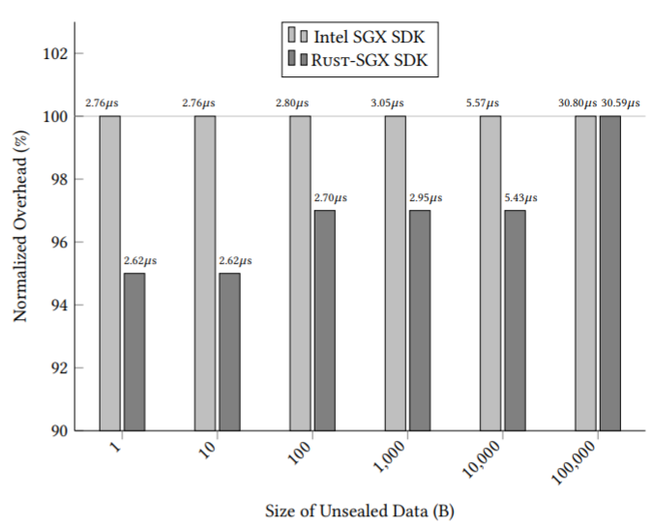
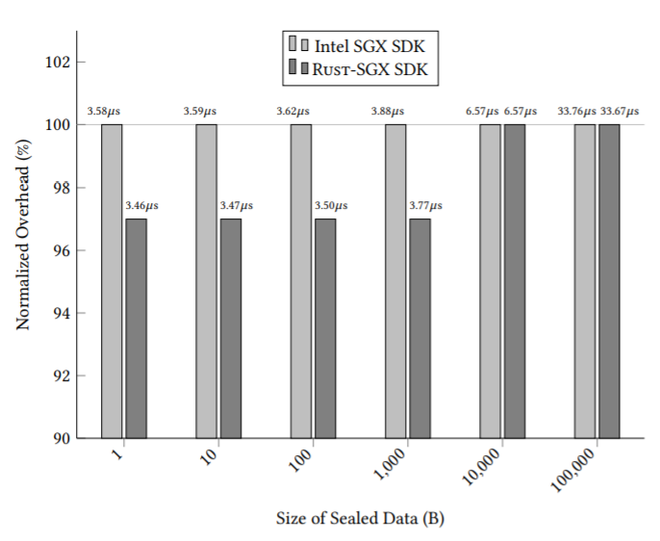
Rust-SGX (CCS’19)
Motivation
The key objective of Rust-SGX is to remove memory corruption vulnerabilities inside SGX enclave by enabling the enclave software development with memory safe languages.
Contributions
A practical and layered approach to exterminating memory corruptions for SGX enclave programs. We propose the use of type safety and formal proof to handle the unsafe components when dealing with a layered memory safety model. Our evaluation results show that Rust-SGX fully preserves the SGX functionality and meanwhile does not impose any significant performance overhead.
System Overview
Results

Slide 76
Outline
❶ Introduction
❷ Our Efforts
❸ Applications
❹ Takeaway

Slide 77
Application I: Medical Records Sharing

Slide 78
Application I: Medical Records Sharing

Slide 79
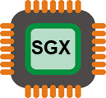
Application I: Medical Records Sharing

Slide 80
Application I: Medical Records Sharing
Diagnosis
Assessment
Research
Disease Control

Slide 81
Application I: Medical Records Sharing
Diagnosis
Assessment
Research
Disease Control

Slide 82
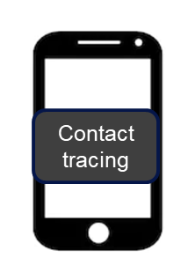
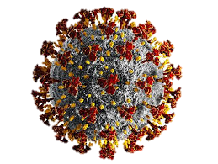
Application II: Privacy-Preserving Contact Tracing
SGX
Encrypted data
Encrypted data
Contact tracing
Sturzenegger, David, Aetienne Sardon, Stefan Deml, and Thomas Hardjono. "Confidential Computing for Privacy-Preserving Contact Tracing." arXiv preprint arXiv:2006.14235 (2020).

Slide 83
Application III: Using TEE to Protect Computer Games

Slide 84
Application III: Using TEE to Protect Computer Games
The global video game market size was valued at USD 151.06 billion in 2019 and is expected to grow at a Compound Annual Growth Rate (CAGR) of 12.9% from 2020 to 2027 [3].
[3] https://www.grandviewresearch.com/industry-analysis/video-game-market
[4] https://www.forbes.com/sites/nelsongranados/2018/04/30/report-cheating-is-becoming-a-big-problem-in-online-gaming/?sh=41edbbe87663

Slide 85
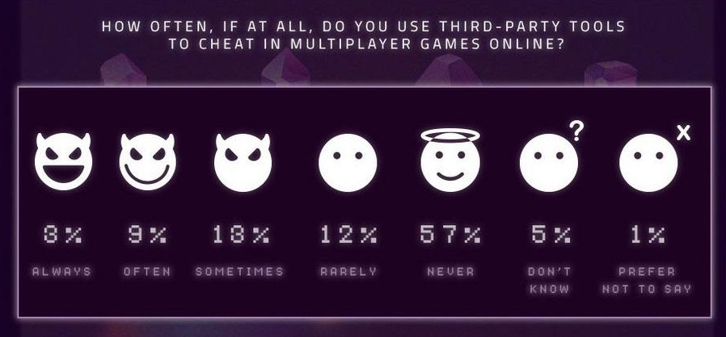
Application III: Using TEE to Protect Computer Games
The global video game market size was valued at USD 151.06 billion in 2019 and is expected to grow at a Compound Annual Growth Rate (CAGR) of 12.9% from 2020 to 2027 [3].
A total of 37% of gamers confessed to cheating (3% "always", 9% "often", 13% "sometimes", and 12% "rarely" [4]).
[3] https://www.grandviewresearch.com/industry-analysis/video-game-market
[4] https://www.forbes.com/sites/nelsongranados/2018/04/30/report-cheating-is-becoming-a-big-problem-in-online-gaming/?sh=41edbbe87663

Slide 86
Application III: Using TEE to Protect Computer Games
The global video game market size was valued at USD 151.06 billion in 2019 and is expected to grow at a Compound Annual Growth Rate (CAGR) of 12.9% from 2020 to 2027 [3].
A total of 37% of gamers confessed to cheating (3% "always", 9% "often", 13% "sometimes", and 12% "rarely" [4]).
Game currency = 100
Game currency = 100
Game currency = 100
[3] https://www.grandviewresearch.com/industry-analysis/video-game-market
[4] https://www.forbes.com/sites/nelsongranados/2018/04/30/report-cheating-is-becoming-a-big-problem-in-online-gaming/?sh=41edbbe87663

Slide 87
Application III: Using TEE to Protect Computer Games
The global video game market size was valued at USD 151.06 billion in 2019 and is expected to grow at a Compound Annual Growth Rate (CAGR) of 12.9% from 2020 to 2027 [3].
A total of 37% of gamers confessed to cheating (3% "always", 9% "often", 13% "sometimes", and 12% "rarely" [4]).
Game currency = 100
Game currency = 100
Game currency = 100
[3] https://www.grandviewresearch.com/industry-analysis/video-game-market
[4] https://www.forbes.com/sites/nelsongranados/2018/04/30/report-cheating-is-becoming-a-big-problem-in-online-gaming/?sh=41edbbe87663

Slide 88
Application III: Using TEE to Protect Computer Games
The global video game market size was valued at USD 151.06 billion in 2019 and is expected to grow at a Compound Annual Growth Rate (CAGR) of 12.9% from 2020 to 2027 [3].
A total of 37% of gamers confessed to cheating (3% "always", 9% "often", 13% "sometimes", and 12% "rarely" [4]).
Game currency = 1000
Game currency = 100
Game currency = 100
Game currency = 100
[3] https://www.grandviewresearch.com/industry-analysis/video-game-market
[4] https://www.forbes.com/sites/nelsongranados/2018/04/30/report-cheating-is-becoming-a-big-problem-in-online-gaming/?sh=41edbbe87663

Slide 89
Application III: Using TEE to Protect Computer Games
Notes:
https://lifeasageek.github.io/papers/seonghyun-blackmirror.pdf

Slide 90
Application III: Using TEE to Protect Computer Games
Data Integrity
Prevent modifications to data Protect code that does modify data
Code Integrity
Prevent modifications to crucial code Move necessary code to enclave

Slide 91
Application III: Using TEE to Protect Computer Games
Data Integrity
Prevent modifications to data Protect code that does modify data
Code Integrity
Prevent modifications to crucial code Move necessary code to enclave
Challenges
Each game requires protection of different content
Directly using SGX requires partitioning of the software, which is difficult
- Existing games not designed with isolated component
- Many code dependencies
- Can lead to too much code in enclave
- Difficult to balance enclave size with securing enough code/data
Many assets could be leaked due to lack of secure I/O

Slide 92
Application III: Using TEE to Protect Computer Games
Data Integrity
Prevent modifications to data Protect code that does modify data
Code Integrity
Prevent modifications to crucial code Move necessary code to enclave
User Platform
Authenticated Server
Game
User Interface
Enclave
Challenges
Encrypted
Resources
Each game requires protection of different content
Directly using SGX requires partitioning of the software, which is difficult
- Existing games not designed with isolated component
- Many code dependencies
- Can lead to too much code in enclave
- Difficult to balance enclave size with securing enough code/data
Many assets could be leaked due to lack of secure I/O
File Systems
Encrypted Resources
Sealed Key
[5] Bauman, Erick, and Zhiqiang Lin. "A case for protecting computer games with SGX." In Proceedings of the 1st Workshop on System Software for Trusted Execution, pp. 1-6. 2016.
[6] Park, Seonghyun, Adil Ahmad, and Byoungyoung Lee. "BlackMirror: Preventing Wallhacks in 3D Online FPS Games." In Proceedings of the 2020 ACM SIGSAC Conference on Computer and Communications Security, pp. 987-1000. 2020.

Slide 93
Outline
❶ Motivation
❷ Our Efforts
❸ Applications
❹ Takeaway

Slide 94
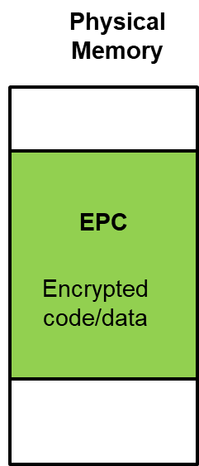
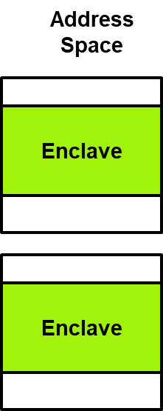
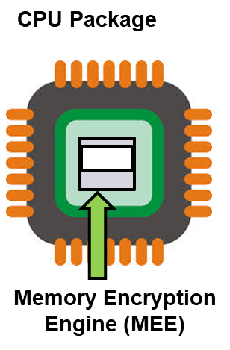
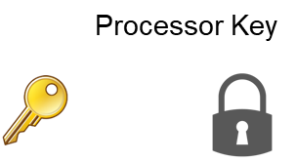
Takeaway
Medical Records Sharing
SGX-Log
[ASIACCS’17]
Privacy Preserving Contact Tracing
Game Protection [Systex’16]
Applications
Tools/SDKs/
Frameworks
SGX-Rand [ESORICS’17]
SGX-LAPD
[RAID’17]
SGX-BigMatrix
[CCS’17]
SGX-Elide
[CGO’18]
Rust-SGX
[CCS’19]
Hardware

Slide 95
Acknowledgement

Slide 96
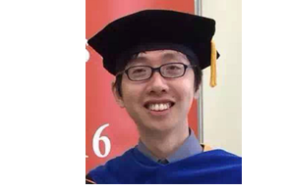
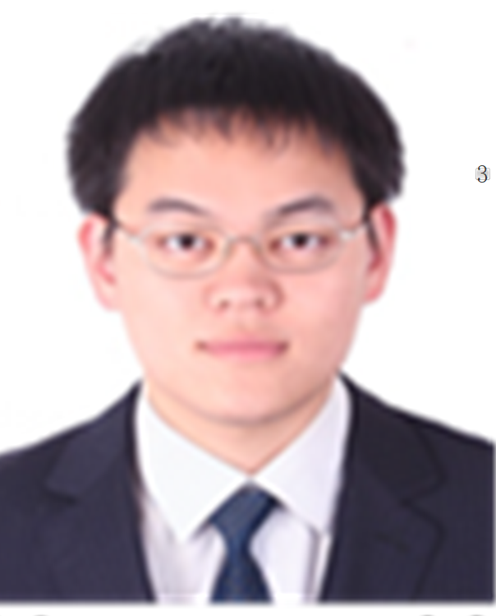
Acknowledgement

Slide 97
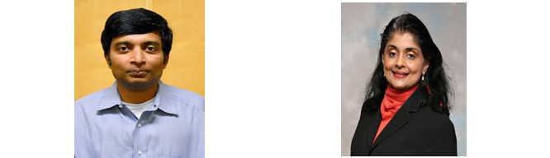
Acknowledgement

Slide 98
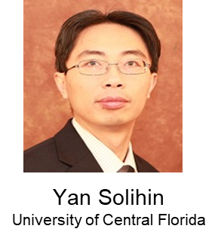
Acknowledgement

Slide 99
Acknowledgement
TWC: Medium: Collaborative: Systems, Tools, and Techniques for Executing, Managing, and Securing SGX Programs
SDI-CSCS: Collaborative Research: S2OS Enabling Infrastructure-Wide Programmable Security with SDI

Slide 100
Thank You
Computer Security Laboratory
Towards Confidential Computing with Trusted Execution Environment
Zhiqiang Lin
zlin@cse.ohio-state.edu
3/11/2021
THE OHIO STATE UNIVERSITY

